Slide 1
MultiSpeak ® - Explaining Version Differences
TechAdvantage 2015
Orlando, Florida
February 24, 2015
Copyright ©, 2000-2015, CES.

Slide 2
Overview
What is the status of the active versions?
Important differences between Versions 3.0, 4.1 and 5.0
What is new in Version 5.0
Changes between V4.1 and V5.0 use cases

Slide 3
MultiSpeak Version 3.0 Status
First issued in 2005.
V3.0, build z is the latest public release.
V3.0 build ac, issued 8/2012, is available to members.
No additional development will be done on V3.0.
Version 3.0, build ac was adopted for inclusion in SGIP Catalog of Standards.

Slide 4
MultiSpeak Version 4.1 Status
First released 2009.
Latest release of Version 4.x is V4.1.6; issued 8/31/2012.
Version 4.1.x was adopted as part of the NIST Smart Grid Standards Framework.

Slide 5
MultiSpeak Version 5.0 Status
Development started nearly 5 years ago.
First version ever subjected to pre-release plug fest testing.
Version 5.0.7 Release (for commercial development) issued 2/20/2015.
New security standard was also adopted for inclusion in SGIP Catalog of Standards. Applies to all web services versions (V3.0, V4.1 and V5.0).

Slide 6
Focus of Major Versions
Version | Date of First Release | Technical Focus | Market Focus
V2.2 | 2003 | Real-time messaging | GIS, DMS, OMS, SCADA
V3.0 | 2005 | Web services | AMI, remote connect/disconnect, prepayment metering
V4.1 | 2010 | UML-based data model | MDM, DR, AVL
V5.0 | 2015 | Current best-practices in web services Improving message consistency Data model and message improvements to facilitate future harmonization w/ other standards | Work Management, asset management
Notes:
Why do we release a new whole number version:
Hopelessly broken –V2.1
Need to make significant breaking changes V3-V4.x
New technology coming that will change what we want to accomplish
Discuss backward compatibility. Rules for sub-versions/versions. Every release of a whole number must be backward compatible (20 releases of V3)
Note that V3 is most heavily implemented, but is 10 years old – a century in Internet time!
Web services have changed dramatically; we have learned a lot as an industry.
V4.1 was primarily to support the CRN regional demonstration project, not enough time to make all of the needed changes and meet the project deadlines.
We have been working on V5 for 4 years, took the time to do it as well as we know how. Expect it to be the current version for at least 7-10 years.

Slide 7
Version Capabilities Comparison
Capabilities
V3.0
V4.1
V5.0
Meter Reading
Connect/Disconnect
Prepaid Metering
Staking/Field Design
GIS
Distribution Connectivity
Transmission Connectivity
Engr’g Database Exchange
Direct Load Control
Demand Response
Outage Management
SCADA/DMS
X
X
X
X
X
X
X
X
X
X
X
X
X
X
X
X
X
X
X
X
X
Improved
X
X
Improved
Improved
X
X
X
X
X
Improved
X
Notes:
Manners of improvement:
More methods
More objects
More attributes on objects
Better defined
More use case documentation
Improved testing

Slide 8
Version Capabilities Comparison (Continued)
Capabilities
V3.0
V4.1
V5.0
Work Management
AVL
Water and gas metering
Switching Orders
Tagging/Clearances
Asset Management
Demand Management
Inventory Management
Assembly Management
Limited
Limited
Limited
Limited
X
X
X
X
X
Limited
Limited
Improved
Improved
Improved
Improved
New
Improved
New
Improved
Improved

Slide 9
Version Attributes Comparison
Version Attributes
V3.0
V4.1
V5.0
Internationalization
Subscriber endpoint
Subscription management
Unique identifiers
Best practice WSDLs
Clear msg header usage
Error handling
Enumerated string fields
MDM endpoint
Use case documentation
Testing and certification
Optional
Few
X
X
X
Optional
Optional
Limited
Improved
X
Some
X
X
Required
Required
Required
X
X
Improved
Extensible
Streamlined
Improved and Expanded
Improved

Slide 10
Version 3.0 Reference Model

Slide 11
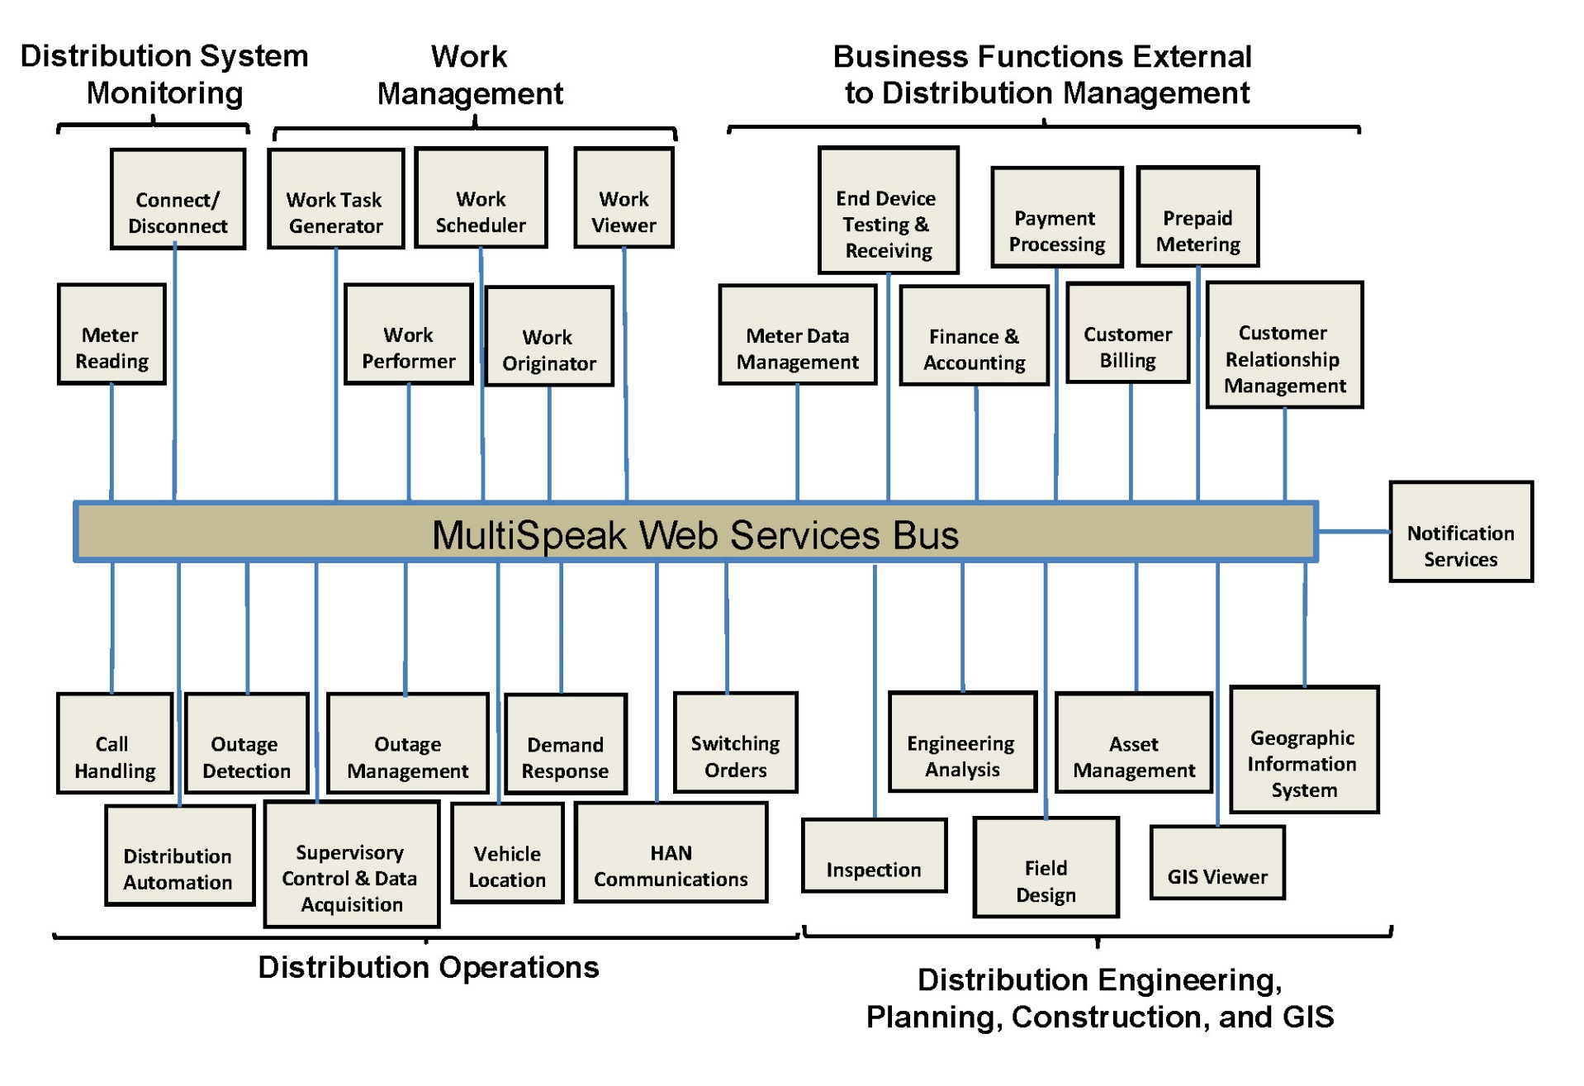
Version 4.x Reference Model

Slide 12
Added in MultiSpeak V4.1
Enhanced support for AMI-focused demand response (included in V4.1.4 and later).
AVL interfaces.
Enhanced support for water and gas metering.
Transmission power system model exchange (including optional IEC CIM CPSM format).
Work management.
Improved distribution power system model exchange.
Internationalization
International telephone and address fields
Unit/value pairs with wide selection of units
Supports all ISO 4217 currency codes

Slide 13
New in MultiSpeak V5.0
Required use of globally unique identifiers (GUIDs) for identifiers of persisted objects. Reduces interoperability problems due to non-unique object identifiers.
Many more string fields are enumerated to improve interoperability. Hard enumerations are built with inherent extensibility for additional custom enumeration values where necessary.
Contract-first WSDL development process resolves issues inherent in the code-first WSDLs used in Versions 3.0 and 4.x.
Enhanced work management interfaces.
Clarified and standardized message naming.
Eliminated circular schema references.
Notes:
Describe contract-first vs code first WSDLs.

Slide 14
New in MultiSpeak V5 (Continued)
Different request and response headers to clarify usage of header attributes.
Improved system state and messaging error handling.
Improved harmonization with IEC CIM, especially with IEC 61968-9, 2nd Edition.
Improved handling of pub/sub interfaces, including required support for subscription management (PUB) and notification clients (NOT).
Reduced duplication of methods being implemented on multiple web services endpoints.
MDM endpoint refactored and streamlined to eliminate duplication.

Slide 15
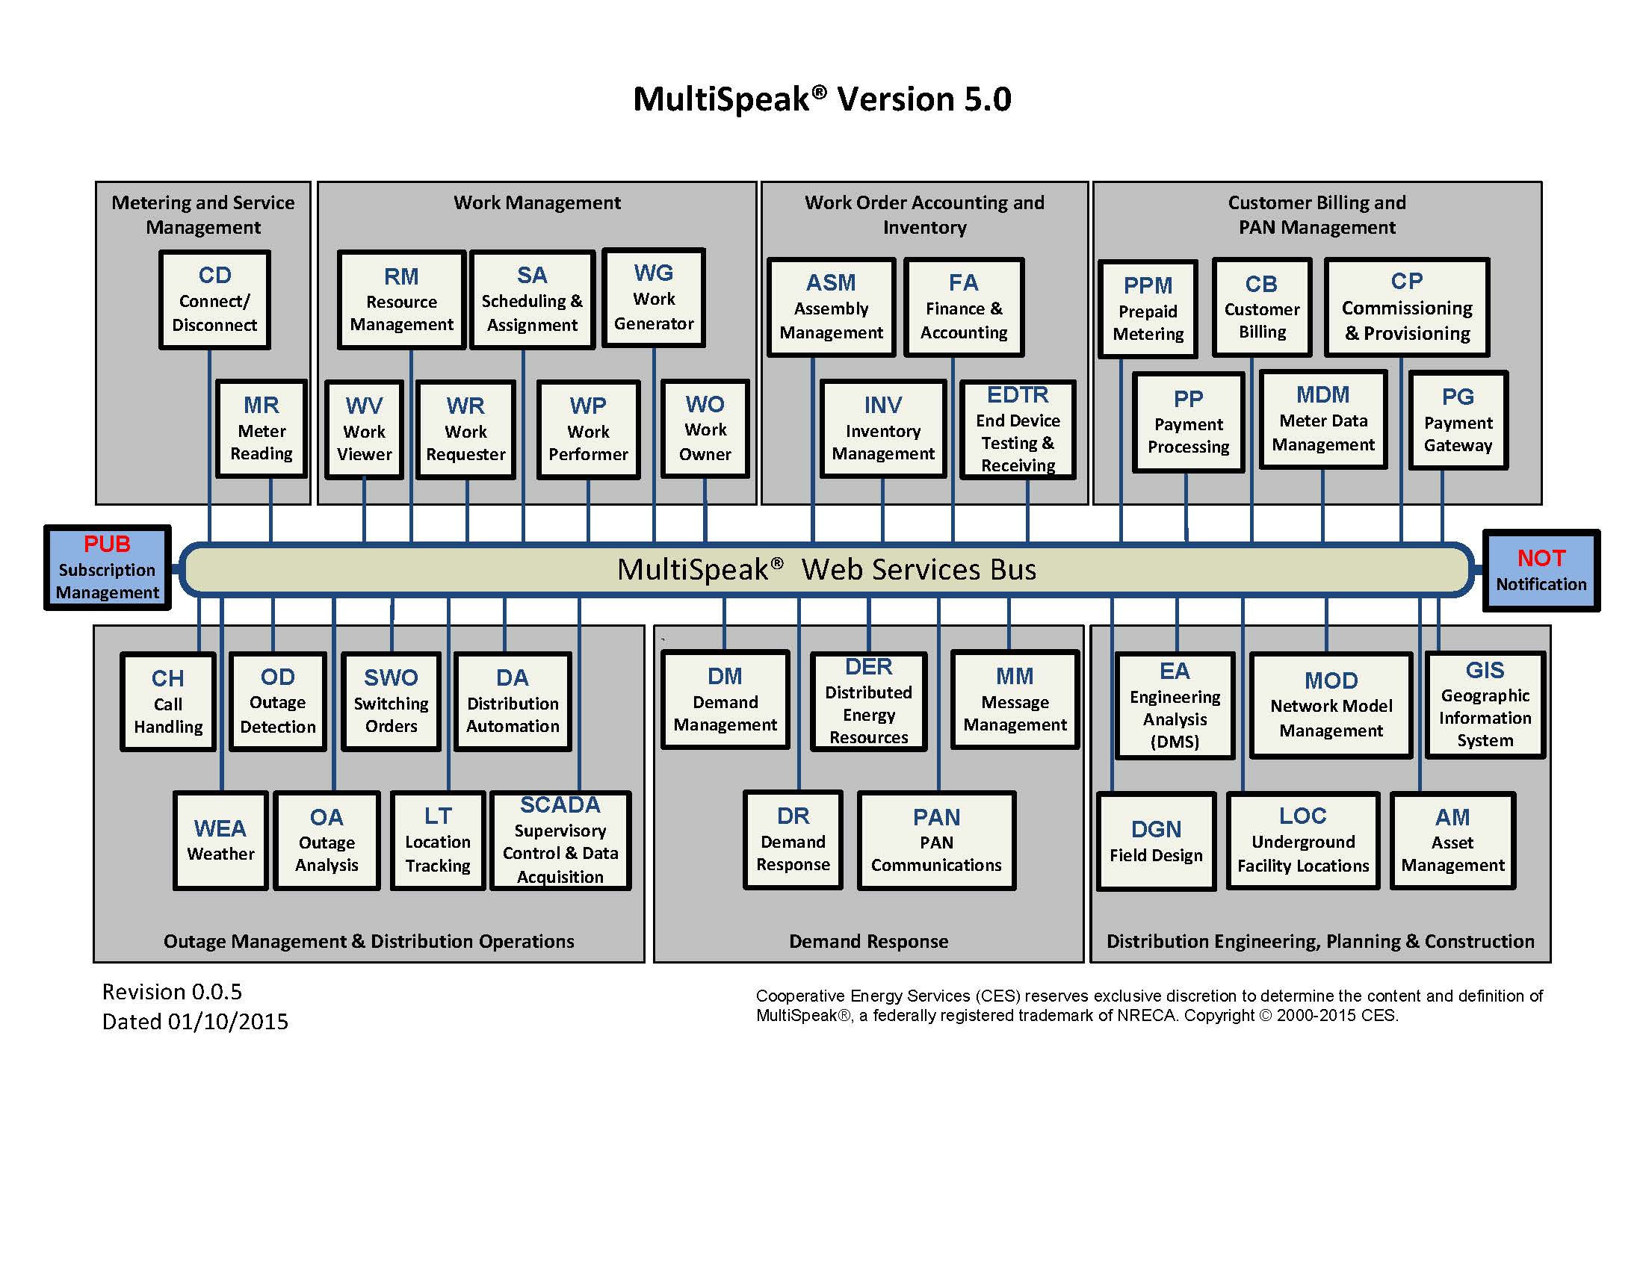
MultiSpeak V5.0

Slide 16
New in V5.0
Ongoing development in V5.0

Slide 17
Common Message Exchange Patterns
Three Message Module Types:
Request/Response Message Module
Publish/Subscribe Message Module
Initiate/Cancel Message Module
Asynchronous Recall Message Exchange (Composite message exchange)
A composite is a combination of two or more modules.
An asynchronous recall composite combines:
An Initiate/Cancel message module
A Publish/Subscribe message module

Slide 18
Example Request/Response Message Module (Version 4.1)

Slide 19
Example Request/Response Message Module (Version 5.0)
Notes:
Note *abstract* system naming. Requesting System might be CIS or EA, or ?
Meter Reading System might be AMI Head End or MDM.

Slide 20
Example Publish/Subscribe Message Module (Version 4.1)

Slide 21
Example Publish/Subscribe Message Module (Version 5.0)
Notes:
Note:
Abstract system naming,
Use of NOT and PUB endpoints.
Change in name of method – increased consistency.

Slide 22
Example Initiate/Cancel Message Module (Version 4.1)

Slide 23
Example Initiate/Cancel Message Module (Version 5.0)
Notes:
Note again, abstract system naming.
Also note consistency, may carry an array of meterIDs.

Slide 24
Example Asynchronous Recall Composite Message Exchange Pattern (Version 4.1)

Slide 25
Example Asynchronous Recall Composite Message Exchange Pattern (Version 5.0)
Notes:
Note:
Abstract system naming.
Use of NOT and PUB endpoints.
Point out self-message.

Slide 26
For Further Information, Contact:
Gary McNaughton
MultiSpeak Technical Coordinator
Cornice Engineering, Inc. 1934 W University Ave Flagstaff, AZ 86001
Phone: (928) 773-1817 Mobile: (928) 864-9059
GMcNaughton@CorniceEngineering.com
Doug Lambert
MultiSpeak Program Manager
NRECA 4301 Wilson Blvd. Arlington, VA 22203
Phone: (703) 907-5851
Mobile: (571) 389-2627
Doug.Lambert@nreca.coop
www.MultiSpeak.org

